Slide 1
Role of DIHs
Speakers:
Rajiv Rajani - CTO - iSHARE Foundation
Tonia Sapia - Marketing Manager - FIWARE Foundation
Angeles Tejado - Senior Mkt Manager - FIWARE Foundation
Rosa Villaronga - Project Manager - Fundingbox

Slide 2
The role of DIHs
About:
This second part of the session elaborates on the DIHs Onboarding process and their Journey
This session will:
Overview and Journey of DIHs in i4Trust
Role of DIHs (LEBDs and Ambassadors)
i4Trust Ambassadors
Engagement in multi-tier support
Structure of Community
How Open calls will work
Overview of open calls process
What constitutes a suitable i4Trust experiment
Scouting process
Support to experiments
FAQ
Goals:
After this session you will understand how you play a key role in enabling the i4Trust ecosystem
Target Audience:
All (LEBDS, Ambassadors)

Slide 3
Journey of DIHs

Slide 4
Journey of DIH
Join
Learn
Disseminate
Participate
Support
Sustain
Discover

Slide 5
What we expect
Bring the understanding of the ecosystem of SMEs in your network, their needs and challenges
Be able to think ahead of SMEs on potential solutions to their challenges and potential new business opportunities and business models around those solutions
Be the local expert for i4Trust and guide SMEs
Get better understanding of i4Trust, firstly through the Train the Trainers Program and secondly through learning-by-doing process while supporting SMEs
Be the local expert in the technical components of i4Trust to support SMEs during the implementation of solutions
Provide the Tier 1 and Tier 2 level support to the SMEs in the multi tier support system and coordinate support with Tier 3 when you cannot resolve issues within Tier 1 and 2
Be actively involved in formation and sustainability of the i4Trust Community

Slide 6
Role of DIH

Slide 7

Profile of 4Trust Ambassadors
Who is our i4Trust Ambassador?
We are looking business oriented profile e.g. Business Manager, Product Manager, Marketing Manager, and similar ones able to:
choose the most promising SMEs, with excellent experiments that can scale the market and be attractive to investors
promote the vision, mission and value proposition of i4Trust
spread the word of i4Trust and be influencer in order to attract new DIH in i4Trust Community
cooperate with i4Trust consortium in all communication and dissemination activities

Slide 8
i4Trust Ambassador Programme Activities (1)
How i4Trust Ambassadors will get global visibility and promotion in cooperation with i4Trust?
building up actions of promotion and networking with i4Trust Consortium (e.g. webinars, Info-Sessions, trade fairs and/or big events (Physical and/or virtual) to promote i4Trust open calls
Ambassadors will be active in the scouting of most promising experiments, they will provide a selection of the best experiments and/or solutions eligible for funding
Showcase in i4Trust’s channels local challenges on different domains during the scouting of promising experiments (fostering cross-domain/cross-border experiments) - No mandatory
Notes:
added-value proposition & welcome pack

Slide 9
i4Trust Ambassador Programme Activities (2)
What kind of Activities Ambassadors can do?
Fostering and Empowering the i4Trust Private Space (i4Trust DIHs Working Group)
Posting on Social Media (Ambassador Account)
Articles / blog posts / references on i4Trust
One local event/meeting/webinar
Communication Kit
Visibility in i4Trust channels (logo, links)
Exclusivity (in community activities)
30K available (15K in 2021 and 15K in 2022) for activities decided and/ or proposed by Ambassadors wit the approval of i4Trust consortium
Win-Win Cooperation
model
Notes:
added-value proposition & welcome pack

Slide 10
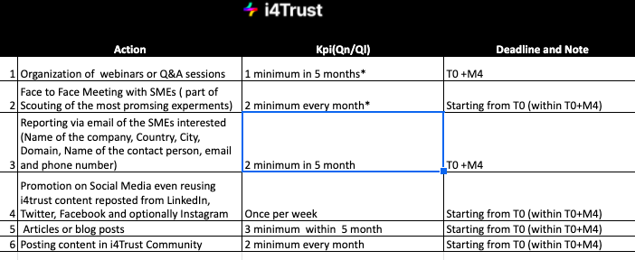
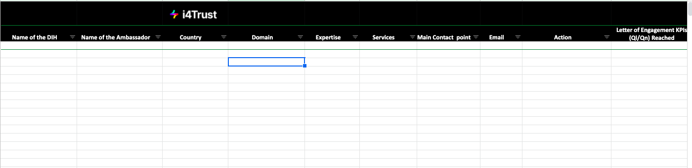
i4Trust Ambassadors Engagement
How, when and where
Ambassadors are engaged?
Letter of Engagement
Monitoring system
Periodic meetings calls

Slide 11
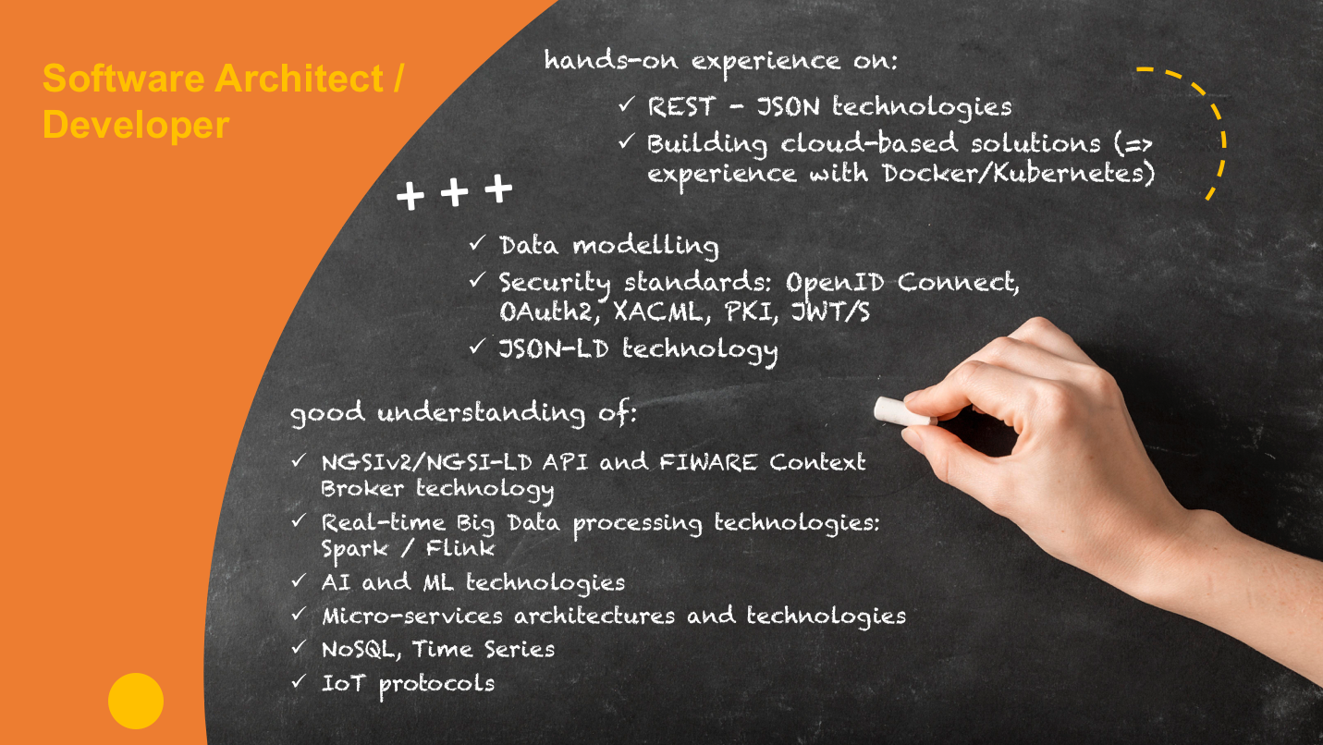
Profile of Local Experts on Data Space - LEBDs
i4Trust LEBDS provide first-level (tier 1 and tier 2) support to SMEs on the i4Trust experimentation framework.
i4Trust LEBDS co-create and fine tune the use cases, connecting additional SMEs to it if necessary.

Slide 12

LEBDs Role
i4Trust DIH’s contact point
i4Trust experimentation framework experts
Hand-on-hand work with SMEs.
Community
of
Practice
Learning-by-doing practice
Technical support - Tier 1 and Tier 2
Business support

Slide 13
LEBDs Engagement in Multi-Tier Support
Tier 2
In-depth business or technical support
Ambassadors will attend locally business requests that cannot be handled by tier 1.
LEBDS with deep knowledge of the i4Trust Data Sharing Enablers will attend locally tech issues that cannot be handled by tier 1.
Tier 3
Tier 3
Expert service support
Specialists provided by i4Trust core partners will solve requests which couldn’t be handled in previous Tiers.
3
2
Tier 2
Tier 0
Self-help / user*-retrieved information
i4Trust Community Portal, FAQs, tech info, blog post, training materials, guidelines, manuals, search functionalities.
Q&A chat, user forums and webinars.
Community management, tech and marketing resources.
Tier 1
Basic help desk resolution and service desk delivery
Tier 1 personnel respond to requests received through help desk feature.
Support for basic and recurrent user issues such as defining experiments and fulfilling service desk requests that need IT involvement.
Lower-level technical questions as well as non-technical questions will be solved by personnel from DIHs that have joined the i4Trust Community
1
Tier 1
0
Tier 0
*Users: SMEs

Slide 14
How open calls will work

Slide 15
i4Trust Open Call in Numbers
32
Bottom-Up Experiments
€3.2 Million
Equity-free funding
9
Months of Mentoring
2
Open Calls

Slide 16





9 month customized mentoring program
Workforce re/up-skilling
i4Trust technology framework
Implementation
Legal, operations, technical, and business
Lump sum ranging from
€72,000 to €120,000

Slide 17
WHO ARE WE LOOKING FOR?

Slide 18
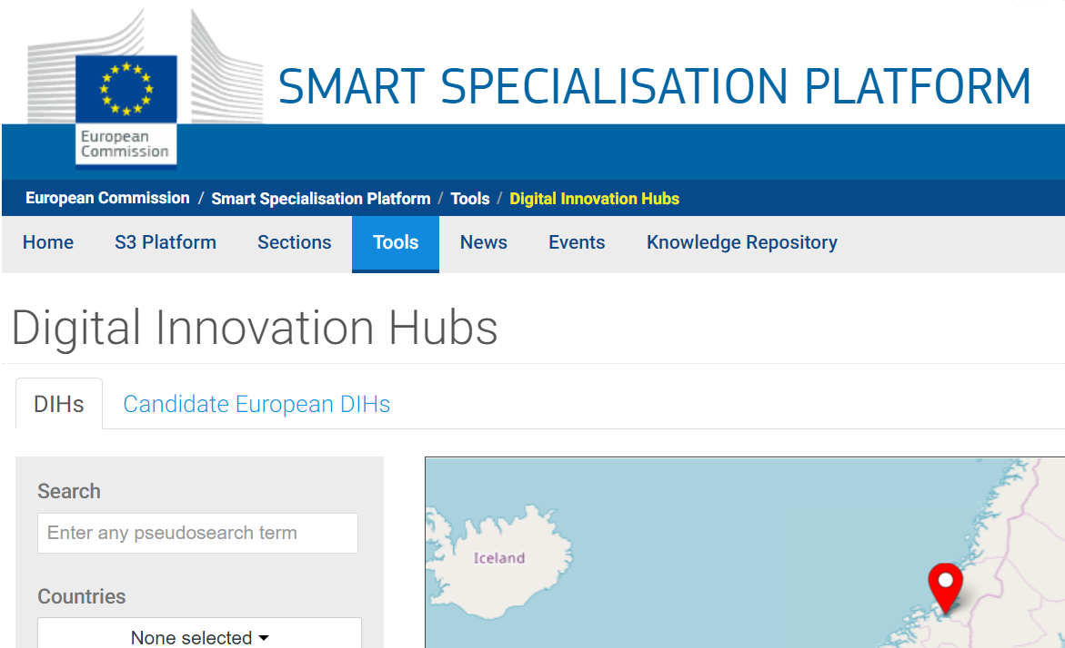
Consortium made up of:
1 DIH
Ideally engaging 5 SMEs or
slightly bigger companies
(minimum 3)
DIH as “in preparation” or “fully operational” in the S3 catalogue by the time the legal check commences during the evaluation process
(approx. October 2021)
Criteria/Legal Status | SME | Slightly Bigger Company
Headcount in Annual Work Unit (AWU) | < 250 | < 500
Annual turnover | Less or equal to 50 million EUR or annual balance sheet total less or equal to 43 million €. | Less or equal to 100 million EUR or annual balance sheet total less or equal to 86 million €.

Slide 19
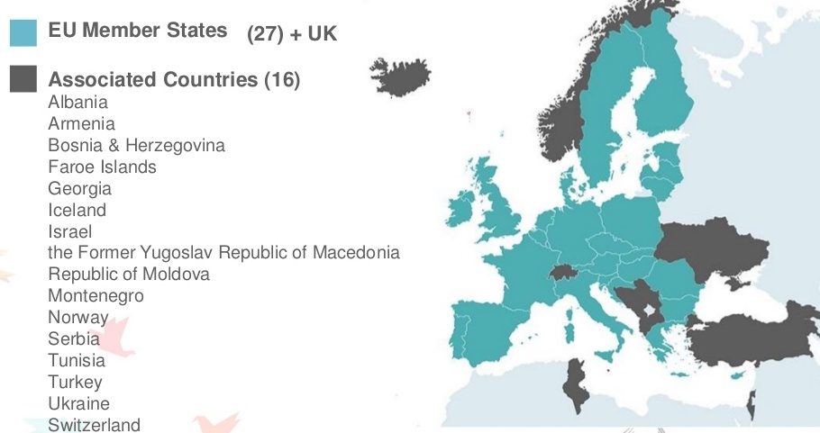
Registered in:
Notes:
An SME will be considered as such if it complies with the Commission Recommendation 2003/361/EC.

Slide 20
HOW TO APPLY

Slide 21
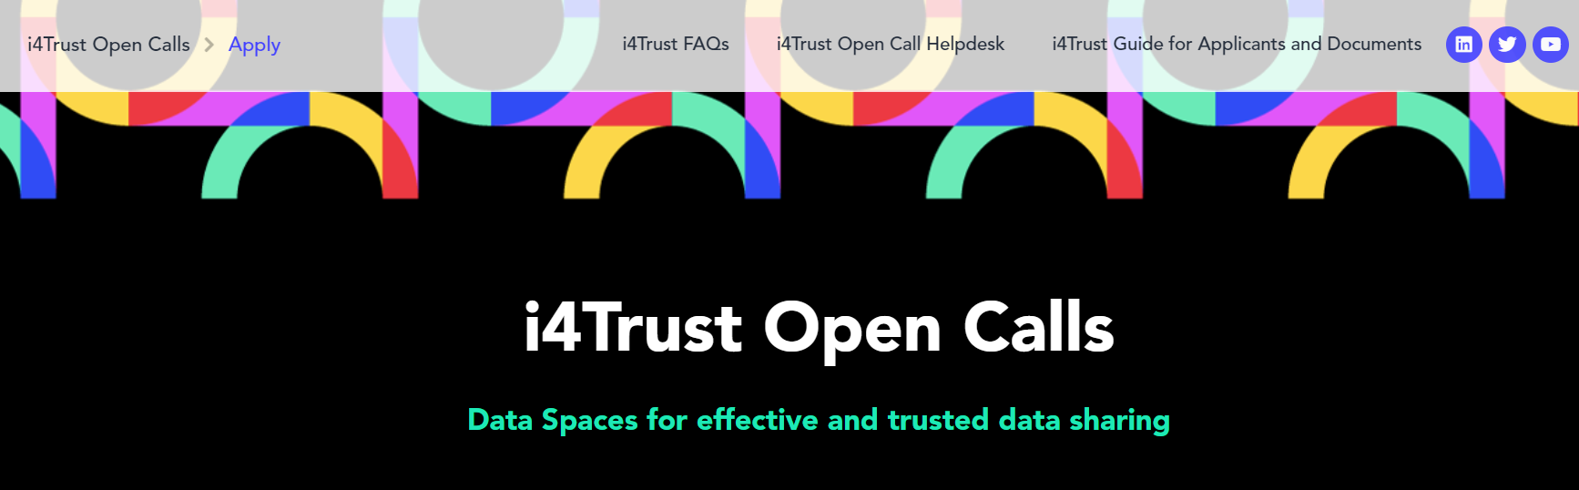
Open Call site: https://i4trust-open-call.fundingbox.com/

Slide 22
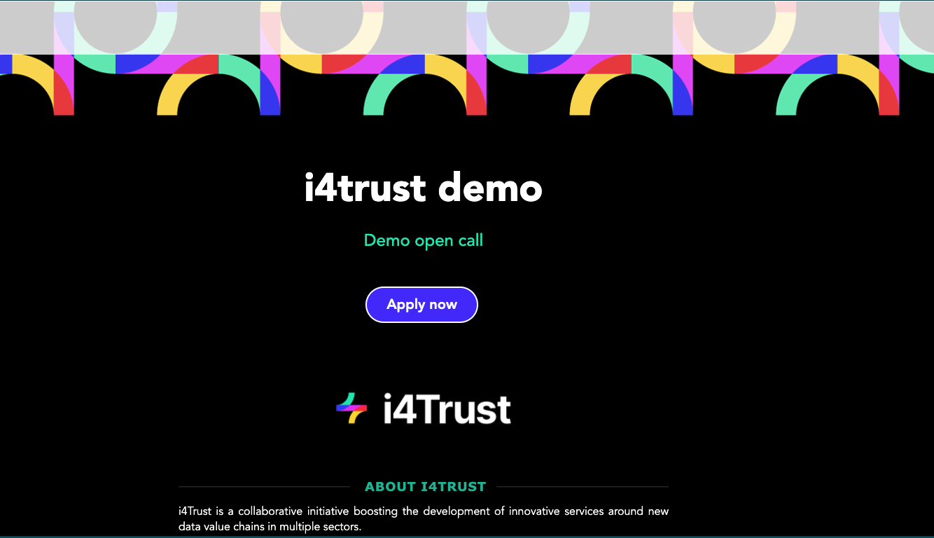
How to apply?
Notes:
Demo

Slide 23
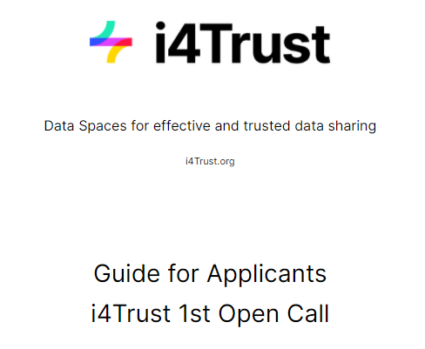
Open Call site: https://i4trust-open-call.fundingbox.com/
REMINDERS
READ the “Guide for Applicants” and “FAQs”
COMPLETE all the sections that are marked with a red asterisk*.
SUBMIT your applications in English and by the deadline

Slide 24
HOW WILL WE EVALUATE AND SELECT YOUR PROPOSAL?

Slide 25
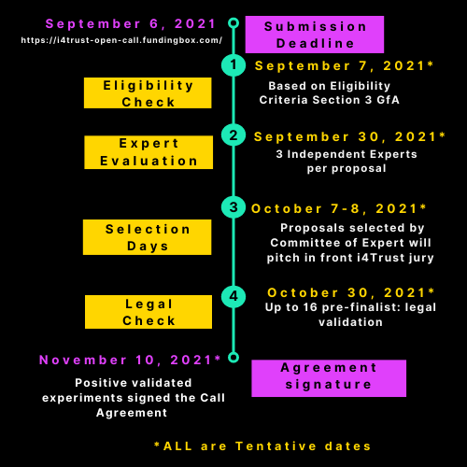
4-step Evaluation Process

Slide 26
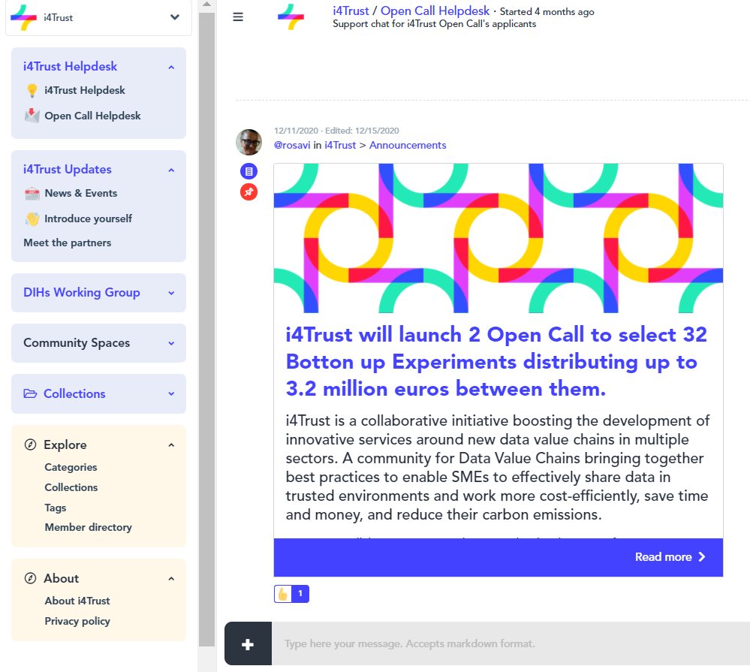
Additional Resources
For additional support:
Join our community space: https://spaces.fundingbox.com/c/i4trust
Read the “Guide for Applicants” and “FAQs”
Email us at
opencall-help@i4Trust.org

Slide 27
What constitutes a suitable experiment
Team
Domain/Challenge
Requirements
i4Trust Components
Ideally 5 SMEs/Slightly Bigger Companies + 1 DIH
Open to all Domains
Exchange of context / digital twin data using FIWARE context broker
Identity and Access Management (IAM) based on iSHARE specifications and framework
Minimum 3 SMEs/Slightly Bigger Companies + 1 DIH
Open to all defined as well as not defined challenges
Experiments should be between TRL3 and TRL8 (inclusive)
Clear Description of digital twin data

Slide 28
Supporting experiments

Slide 29
Support to experiments
Participate
Implement
Sustain
Discover
Journey of SMEs

Slide 30
Mentoring Program
Onboarding
Mentor allocation
Individual mentorship plan
Onboarding
Functional Scoping
Technical Scoping
Solution Design
Use Case Plan
Backlog prioritisation
Implementation plan
Use Case Planning
Finding synergies across the BUEs
Creating links
Proof of Concept
Developing and testing
Conformance Check
Proof of Concept
Fundraising for sustainability
Future steps needed for sustainability
Aftercare
Participant Onboarding
iSHARE Participant

Slide 31
Scouting Process (1)
Ambassadors and LEBDs. will strongly act at local level. Ambassadors have the task to chase the best quality of SMEs acting on the territory
Core partners will act as a “hunter” of most promising experiments, looking for the best SMEs interested and/or specialized in management of data.
Notes:
i4Trust is looking for these SMEs and slightly bigger companies which are filled with ambition and with a strong orientation towards the added value of data as the economy of the present and the future.
Finding out these SMEs/Startups to be involved in the i4Trust Community through experiments funded under the open calls is a core activity to be led by DIHs (LEBDs and Ambassadors) and i4Trust core partners
SMEs that are interested in contributing to the objectives and mission of i4Trust, will be engaged through two different actors:
Ambassadors and LEBDs. These are the stakeholders who will strongly act at local level. Ambassadors have the task to chase the best quality of SMEs acting on the territory. SMEs will be involved in face to face meetings or call meetings (or any other action) that the Ambassadors consider indispensabile to test the level of maturity of the SMEs. Ambassadors will also be able to take advantage of the channels that the i4Trust consortium has made available to them (such as organisation of events, community space, etc..) to encourage and give the opportunity to these SMEs to enter an international networking context.
i4Trust core partners. The i4Trust core partners (FIWARE Foundation, Funding Box and iSHARE Foundation) will act as "dealer of opportunity" for the SMEs reported by the DIHs, to whom they can offer the advantages already explained in the previous point. Core partners will act as a “hunter” of most promising experiments, looking for the best SMEs interested and/or specialized in management of data.

Slide 32
Scouting Process (2)
What kind of SMEs are we looking for?
SMEs with not yet Data Driven Business. They are early adopters to new cross- domain experiments and data-driven business concepts;
SMEs with a medium- strong position in using and re-suing of data. These SMEs are able to contribute and share data. They also have strong competence in management of data;
SMEs with a strong ability to share any kind of data. These SMEs are able to contribute and adopt data, leverage also the possibility to share data from third parties and know well the technologies used for making data publicly available (e.g. companies, organization, Cities).

Slide 33
Scouting Process (3)
Stage
1
SMEs awareness
(i4Trust Data Sharing Enablers)
Engaging potential participants
Marketing activities.: online and offline communication / dissemination activities (contribution from i4Trust core marketing, Ambassadors and LEBDs).
Stage
2
I want to share data
(either get data or send data)
Those with ideas / solutions to solve specific challenges with i4Trust enablers
Meet the experts (Ambassadors, LEBDs and i4Trust Experts)
Common understanding between i4Trust team and participants about the use case. Which issue or solution do they want to solve or enable with i4Trust, both on a data sharing level and IAM level
LEBDs + i4Trust Experts + Data Architect/Business expert from the potential SMEs.
Stage
3
Work out use case
Tiers
Individual scouting
Tier 0: i4Trust Community + help desk
Tier 1: Ambassadors preselection of promising use cases
Tier 2: LEBDs co-create and fine tuning the use case, including connecting additional SMEs to the Use Case
Tier 3: LEBDs introduce the cross-value chain and the cross-border aspects when needed.

Slide 34
Frequently Asked Questions (FAQs)

Slide 35









i4Trust.org
Self-help
i4Trust Community
https://i4trust.org/faq/
Interested in i4Trust?
Updates
Introduce Yourself
News and events
Meet the partners
DIHs Working Group
Train
the
Trainers
i4Trust Help Desk
Open Call Help Desk
i4Trust
Open Call
Ambass.
Program
DIH Working Group
Announcements
Events
Marketing Material
Questions
Info
OC Help Desk
opencall-help@i4Trust.org
Tier 0
self-help resources
Tier 1
Ambassadors
Tier 2
Ambassadors LEBDs
Tier 3
EBDs + LEBDs

